Slide 2
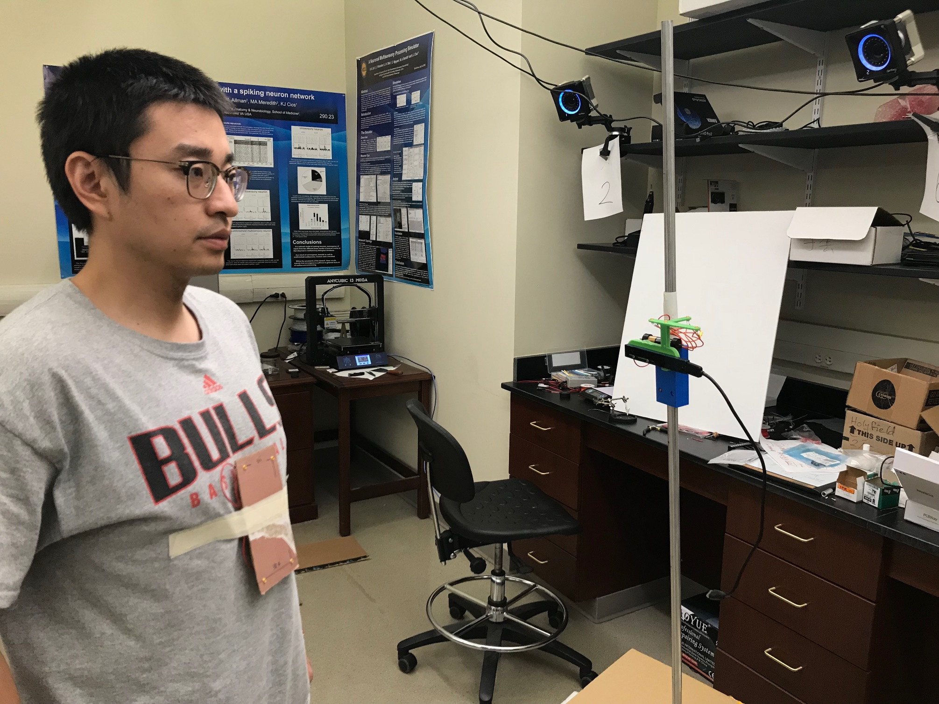
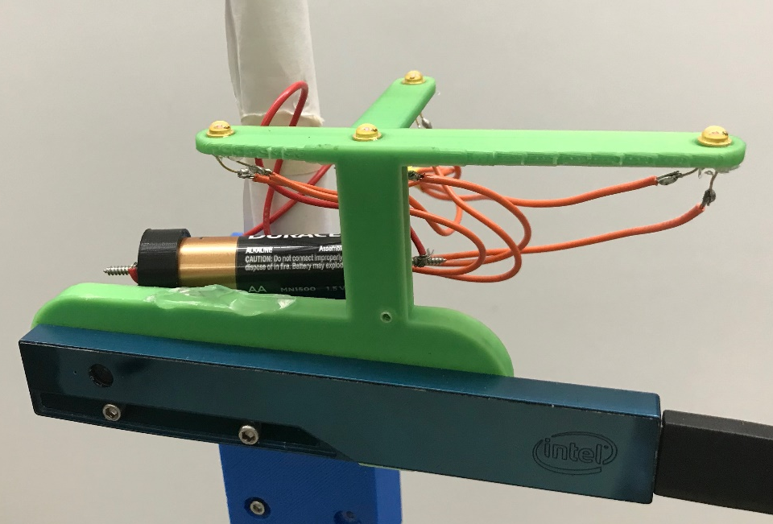













Motion Capture Camera
RealSense R200
IR LED
$$p_{1}$$
$$p_{2}$$
$${\overline{n}}_{o}$$
$$q_{1}$$
$$q_{2}$$
$$q_{4}$$
$$q_{3}$$
$$p_{o}$$
IR LED
$$p_{3}$$
$$p_{4}$$
$$x_{c}$$
$$z_{c}$$
$$y_{c}$$

